Slide 1
CAR PRICE PREDICTION.
Presentation By: PRINCE KUMAR| Internship 31

Slide 2
AGENDA.
Overview.
Problem Statement.
Problem Understanding.
What is Used Car Price Prediction?
Importance of Used Car price prediction.
Exploratory data analysis.
Visualizations.
Model Building.
Hyper Parameter Tuning.
Saving the model and predictions from best saved model.
Conclusion.

Slide 3
OVERVIEW.
In this particular presentation we will be looking on:
How to analyze the dataset of Used Car Price Prediction.
What are the EDA steps in cleaning the dataset.
Overall analysis on the problem.
Model building from the dataset.
Predicting Used Car Price for saved best model.

Slide 4
PROBLEM STATEMENT.
With the covid 19 impact in the market, we have seen lot of changes in the car market. Now some cars are in demand hence making them costly and some are not in demand hence cheaper.
One of our clients works with small traders, who sell used cars. With the change in market due to covid 19 impact, our client is facing problems with their previous car price valuation machine learning models. So, they are looking for new machine learning models from new data. We have to make car price valuation model.

Slide 5
PROBLEM UNDERSTANDING.
The main aim of this project is to predict the price of used car based on various features. Machine Learning is a field of technology developing with immense abilities and applications in automating tasks. So, we will deploy an ML model for car selling price prediction and analysis. This kind of system becomes handy for many people.
This model will provide the approximate selling price for the car based on different features like fuel type, price, running in kms, variant, model etc and this model will help the client to understand the price of used cars.
From the problem statement we came to know that this is a regression type problem, since our target variable “Price” is continuous, hence we need to build regression algorithms to predict the price of used cars.

Slide 6
WHAT IS USED CAR PRICE PREDICTION?
A used car, a pre-owned vehicle, or a second hand car, is a vehicle that has previously had one or more retail owners.
Used cars are sold through a variety of outlets, including rental car companies, independent car dealers, buy here pay here dealerships, leasing offices, auctions, and private party sales.
The increased prices of new cars and the financial incapability of the customers to buy them, Used Car sales are on a global increase.
Therefore, there is an urgent need for a Used Car Price Prediction system which effectively determines the worthiness of the car using a variety of features.

Slide 7
Importance of Used Car Price Prediction.
The prices of new cars in the industry is fixed by the manufacturer with some additional costs incurred by the Government in the form of taxes.
So, customers buying a new car can be assured of the money they invest to be worthy.
But due to the increased price of new cars and the incapability of customers to buy new cars due to the lack of funds, used cars sales are on a global increase.
There is a need for a used car price prediction system to effectively determine the worthiness of the car using a variety of features.
Even though there are websites that offers this service, their prediction method may not be the best.
Besides, it is important to know their actual market value while both buying and selling, to make the right purchase decision.

Slide 8
EXPLORATORY DATA ANALYSIS.
First step of the project, was scraping all the required information from cardekho.com website.
I got 2880 rows & 6 columns after scraping the data. This data was saved in an excel file & a csv file.
I have imported required libraries and I have imported the dataset which was in csv format.
Then I did all the statistical analysis like checking shape, data types, nunique, value counts, info etc.
While checking the data type, I found all the columns to be of object data type. Even our Target column : Price was of object data type.
I used feature extraction techniques to remove the price values from the price column & subsequently changed the data type from object to float.
I also extracted the manufacturing year from the brand column. This increased my column count to 7 columns.

Slide 9
EXPLORATORY DATA ANALYSIS.
I then check the data types once again to see the changes in data types.
I then, checked for null values present in the columns. I found no null values in any columns in the dataset.
Then I checked the the statistical features of our dataset using the describe command.
Finally, I checked if there were any empty values present in our data set. No empty values were present in the dataset.
Next, I proceeded to do some data visualization using various Visualization techniques.

Slide 10
VISUALIZATIONS.

Slide 11
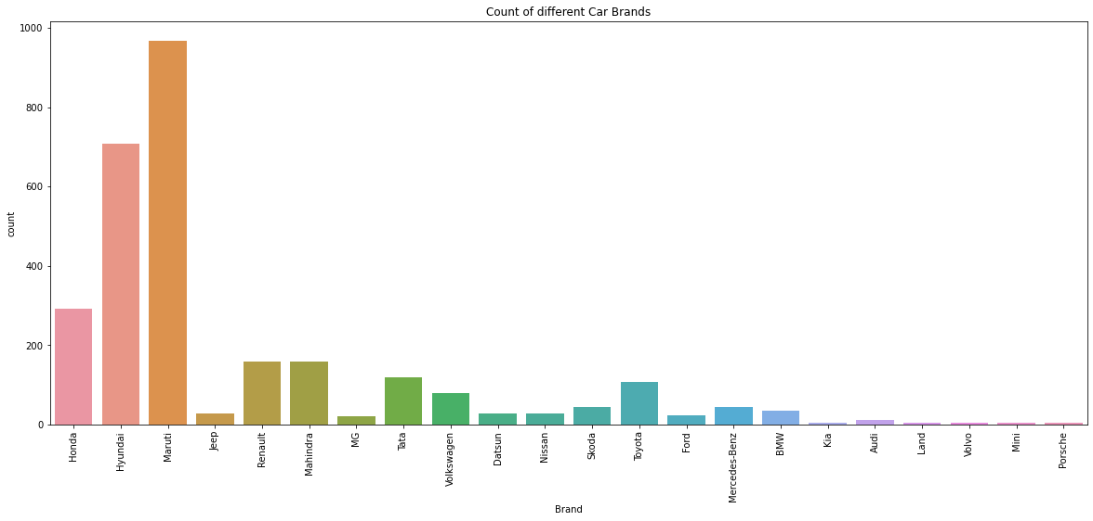
OBSERVATION: Most of the used cars are of the brand Maruti, followed by Hyundai, Honda, Renault, Mahindra, Tata & Toyota. There are very few luxury brand used cars.

Slide 12
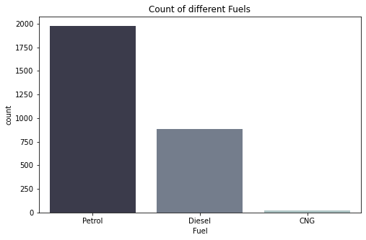
OBSERVATION: The major fuel type is Petrol, followed by Diesel and lastly, CNG.

Slide 13
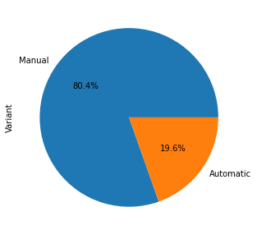
OBSERVATION: Most of the Used cars are of manual Variant (80.4 %). The rest are Automatic (19.6%).

Slide 14
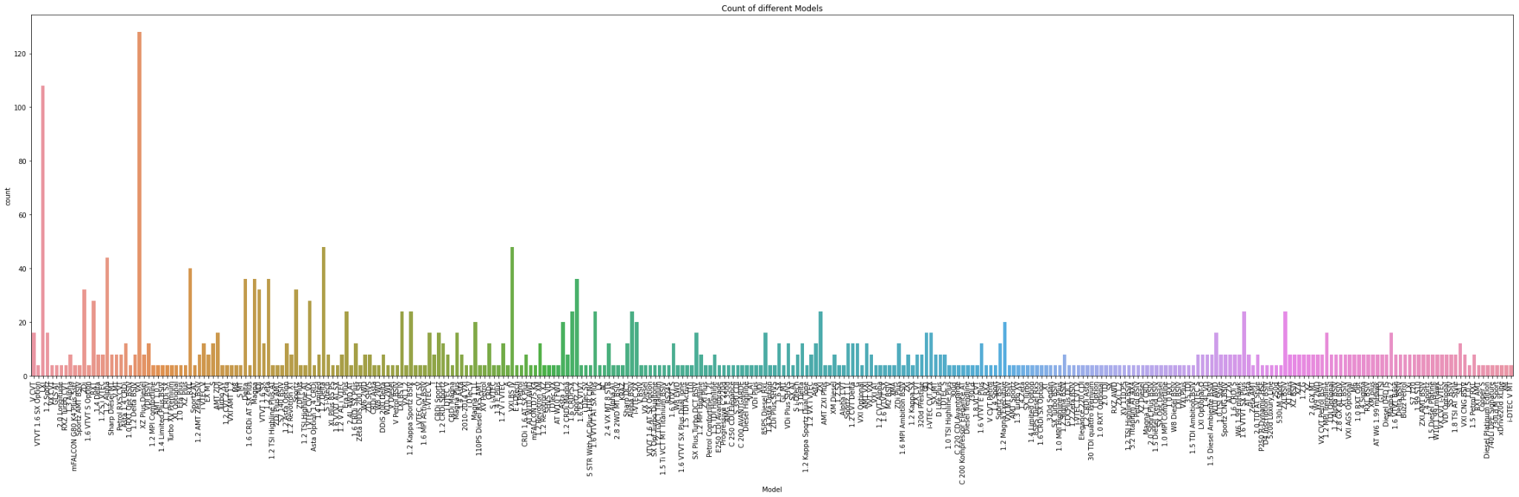
OBSERVATION: The count of VXI, LXI, VXI BS IV, 1.2 Delta & 1.2 Alpha are highest among all the models.

Slide 15
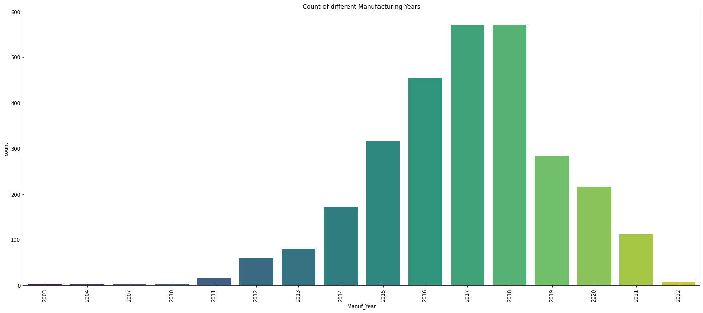
OBSERVATION: Most of the Used cars are manufactured in 2017 and 2018. Followed by 2016, 2015 & 2019.

Slide 16
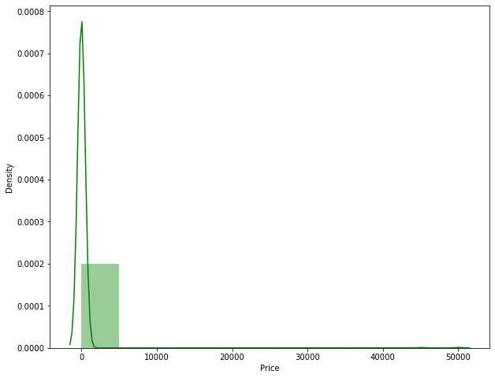
OBSERVATION: The distribution of Price is normal but it is skewed to the right.

Slide 17
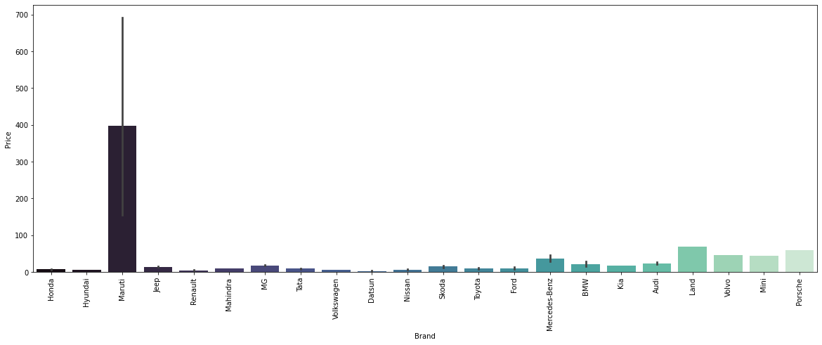
OBSERVATION: Price vs Brand Most of the used cars are of the Maruti Brand. The Prices of Maruti, Mercedes Benz & Audi are high.

Slide 18
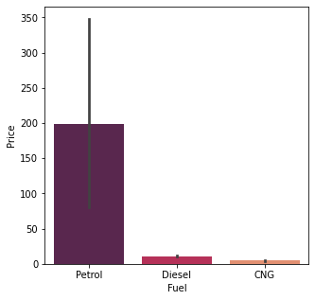
OBSERVATION: Price vs Fuel Most of the cars use petrol as their fuel type, they are also the ones with the highest prices. Next, Diesel and CNG are the lowest .

Slide 19
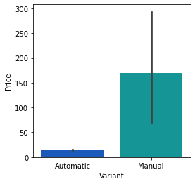
OBSERVATION: Price vs Fuel Most of the used cars are Manual, they are also the ones with the highest prices..

Slide 20
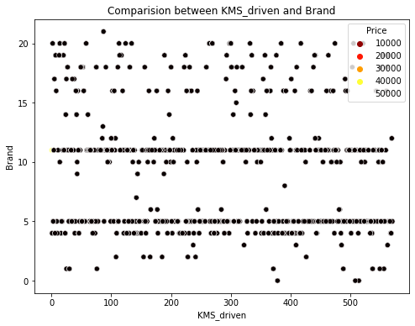
OBSERVATION: The above visualization shows the relationship between KMS_driven and Brand in terms of Price. The majority of the cars have kms driven in between 100 & 500. There are a few outliers present in Brand. There is no positive or negative correlation between either Brand or KMS_driven towards price.

Slide 21
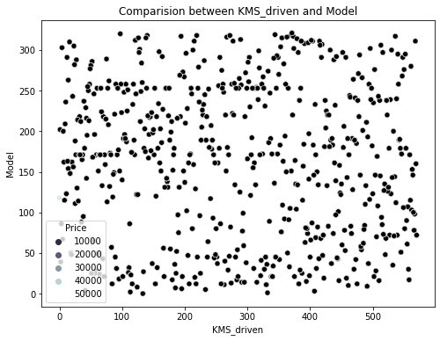
OBSERVATION: The above visualization shows the relationship between KMS_driven and Model in terms of Price. There is no proper relation of the two variables with the target as the Price is scattered all around.

Slide 22
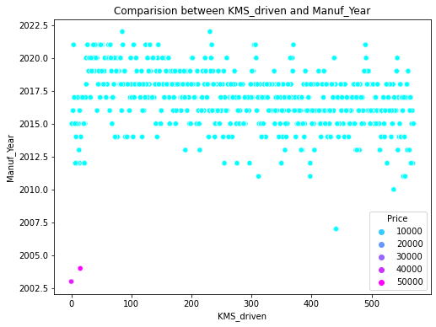
OBSERVATION: The above visualization shows the relationship between KMS_driven and Manuf_Year in terms of Price. Most of the car's manufacturing years are between 2015 & 2020. There are outliers present in the Manuf_Year column. Manuf_Year is positively correlated with our target Price.

Slide 23
MODEL BUILDING.
Since Price was my target and it was a continuous column so this particular problem was a regression problem. And I have used all regression algorithms to build my model.
By looking into the r2 score and cross validation score I found ExtraTreesRegressor as a best model with high scores.
Also to get the best model we have to run through multiple models and to avoid the confusion of overfitting we have to go through cross validation.

Slide 24
REGRESSION MODELS.
regression

Slide 25
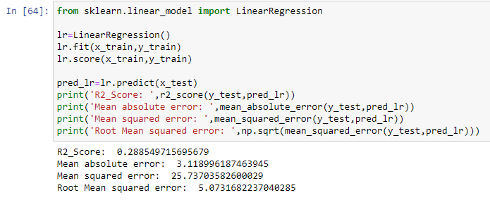
LINEAR REGRESSION MODEL.
The Linear Regression model gave us an R2 Score of 28.85 %.

Slide 26
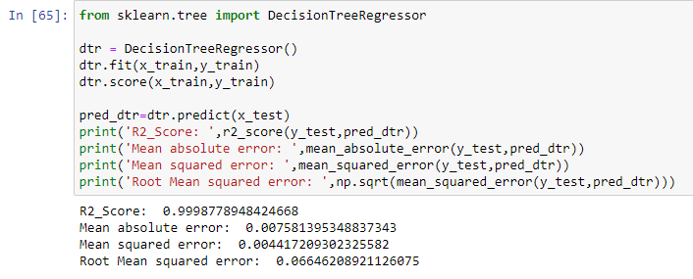
DECISION TREE REGRESSOR.
The Decision Tree Regressor Model gave us a R2 Score of 99.98 %.

Slide 27
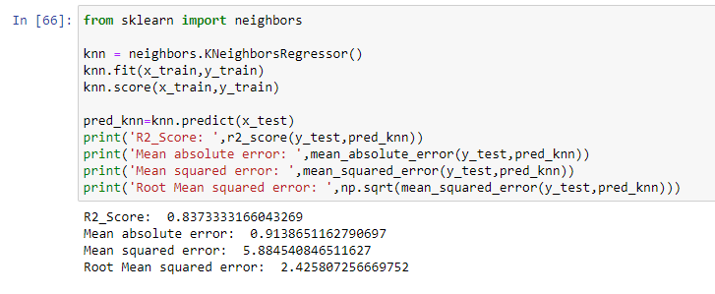
K-NEAREST NEIGHBORS REGRESSOR.
The K-Nearest Neighbors Regression Model gave us a R2 Score of 83.73 %.

Slide 28
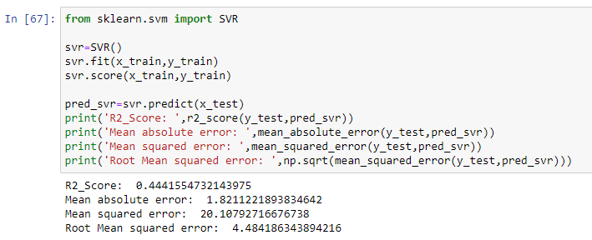
SUPPORT VECTOR REGRESSOR (SVR).
The SVR Model gave us a R2 Score of 44.41 %.

Slide 29
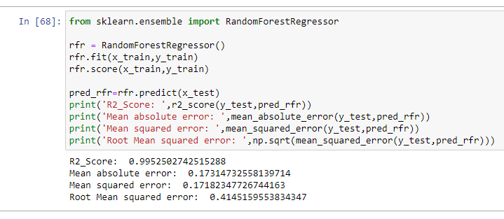
RANDOM FOREST REGRESSOR.
The Random Forest Regression Model gave us a R2 Score of 99.52 %.

Slide 30
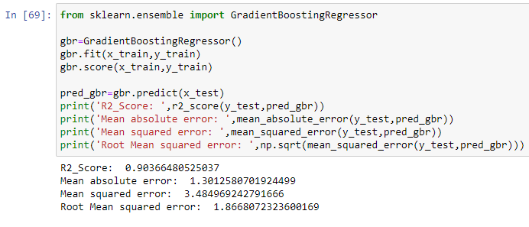
GRADIENT BOOSTING REGRESSOR.
The Gradient Boosting Regressor Model gave us a R2 Score of 90.36 %.

Slide 31
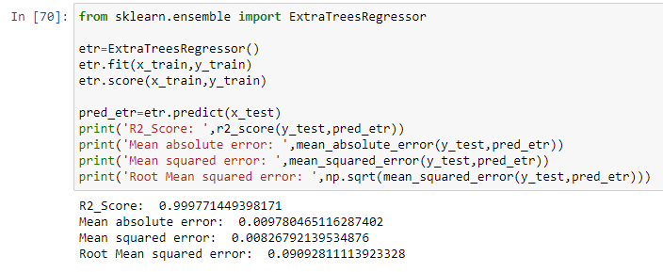
EXTRA TREES REGRESSOR.
The Extra Trees Regressor Model gave us a R2 Score of 99.97 %.

Slide 32
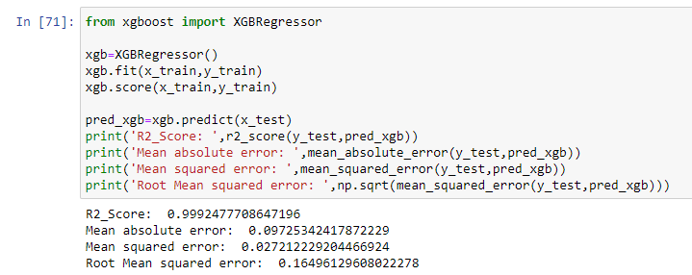
XGBOOST REGRESSOR.
The XGBoost Regressor Model gave us a R2 Score of 99.92 %.

Slide 33
CROSS VALIDATION SCORES.
The cross validation score of the Linear Regression Model is 13.25 %.
The cross validation score of the Decision Tree Regressor Model is -18.62 %.
The cross validation score of the K-Nearest Neighbors Regression Model is -21.49 %.
The cross validation score of the SVR Model is 28.24 %.
The cross validation score of the Random Forest Regressor Model is 30.55 %.
The cross validation score of the Gradient Boosting Regressor Model is 31.41 %.
The cross validation score of the Extra Trees Regressor Model is 46.65 %.
The cross validation score of the XGBoost Regressor Model is 28.01 %.

Slide 34
HYPER PARAMETER TUNING.
Since the R2 Score & Cross Validation Score are both the highest in Extra Trees Regressor we shall consider it for hyper parameter tuning.
We will use GridSearchCV for hyper parameter tuning.

Slide 35
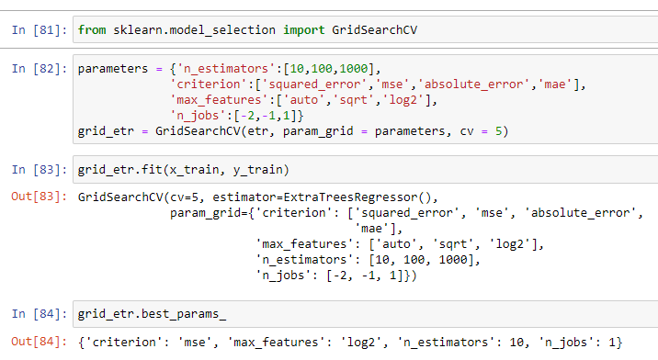
HYPER PARAMETER TUNING.

Slide 36
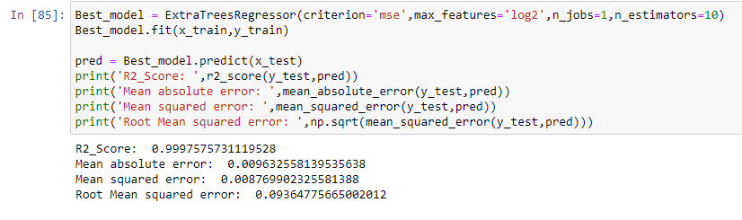
HYPER PARAMETER TUNING.
After Hyper Parameter Tuning, we have got a better R2 score of 99.97 %.

Slide 37

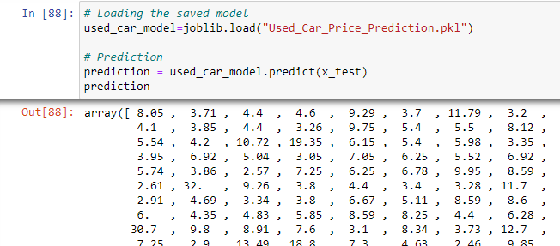
SAVING THE BEST MODEL.
Now we shall save the best model (Extra Trees Regressor after hyper parameter tuning) and make predictions.

Slide 38
CONCLUSION.
In this project report, we have used machine learning algorithms to predict the prices of used cars. After the completion of this project, we got an insight of how to collect data, pre-processing of the data, analyzing the data, cleaning the data and building a model.
In this study, we have used multiple machine learning models to predict the sale price of the used cars. We have gone through the data analysis by performing feature engineering, finding the relation between features and target through visualizations. And got the important features and we used these features to predict the car price by building ML models.
After training the model we checked CV score to overcome the overfitting issue. Performed hyper parameter tuning on the best model and the best model’s R2 score increased and was giving R2 score as 99.97 %. We have also got good prediction results of car prices.

